Slide 1
DECISION TREES
Main reference: Chapter 6 of Géron, A. (2019). Hands-on machine learning with Scikit-Learn, Keras, and TensorFlow.

Slide 2





Introduction
Decision Trees are versatile ML algorithms:
Capable of fitting complex datasets:
Fundamental components of Random Forests:
Limitations of Decision Trees?

Slide 3
First example
Training and visualizing a Decision Tree.
>> Code

Slide 4
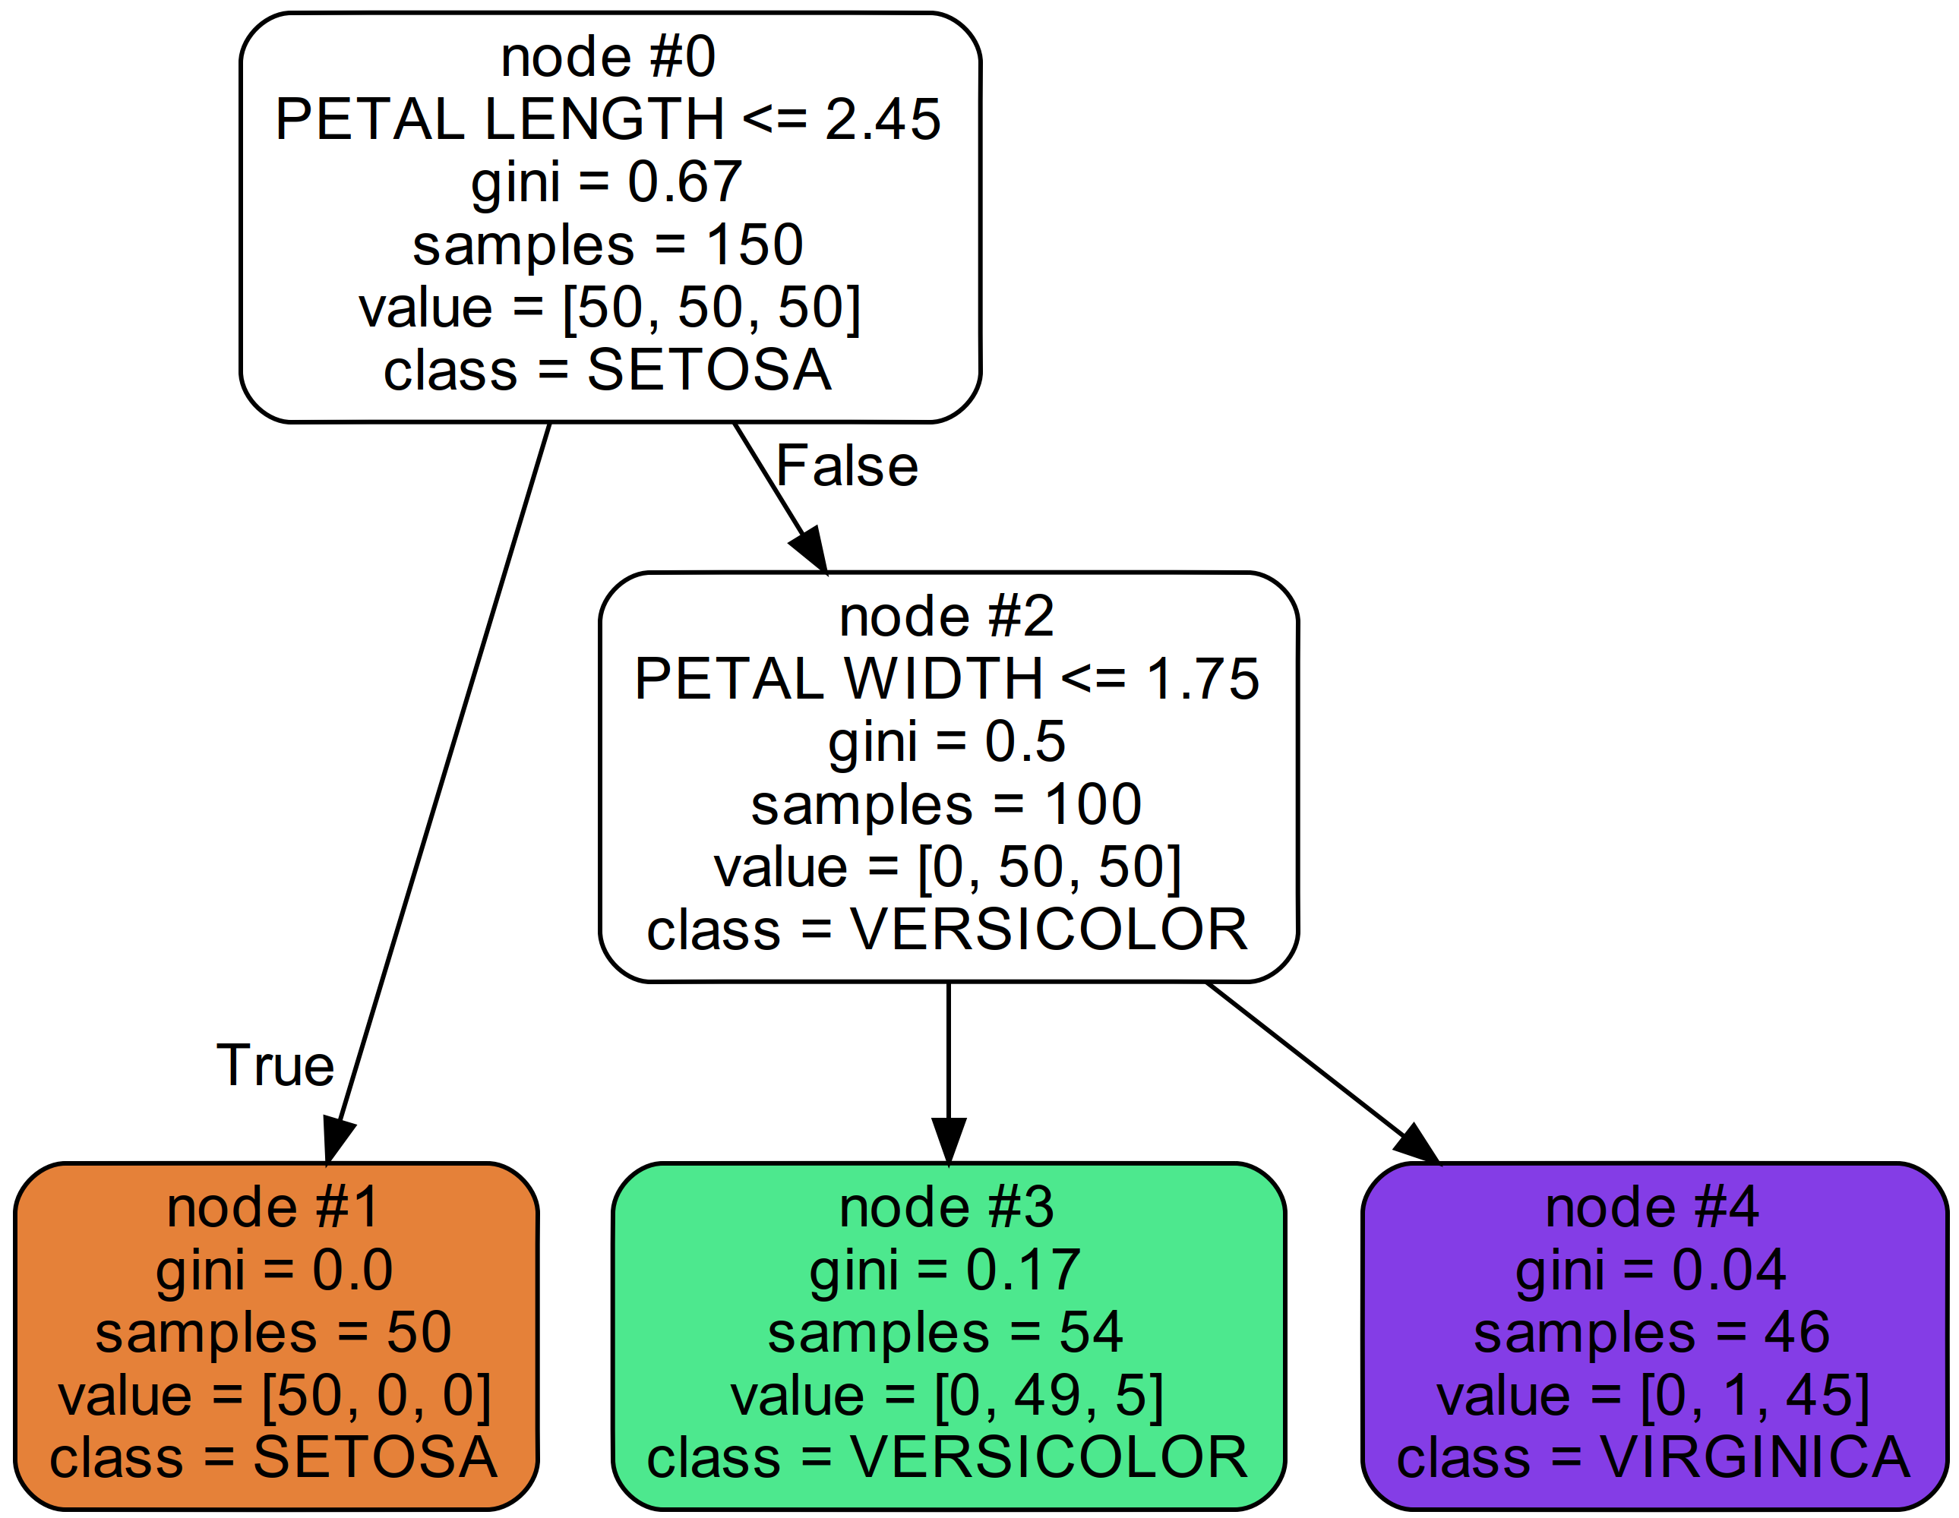












Making predictions

Slide 5






Making predictions
Estimating class probabilities:

Slide 6







Decision trees
A decision tree:
Training algorithm used to create the tree:

Slide 7









Nodes’ attributes

Slide 8







Gini – an impurity measurement
Measures node’s impurity:
For example:

Slide 9
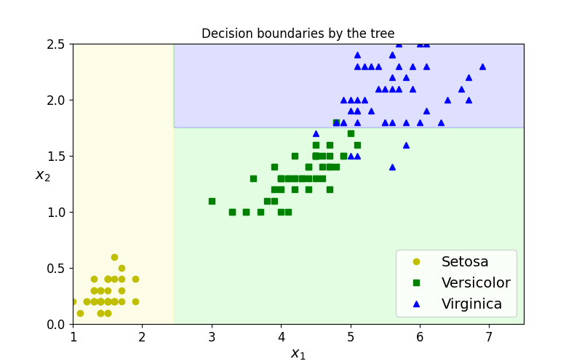













Decision boundaries

Slide 10
CART training algorithm

Slide 11








CART algorithm
To train (or to “grow”) Decision Trees.
Idea:
Choose a feature k and a threshold t_k:
Stop when reaches

Slide 12
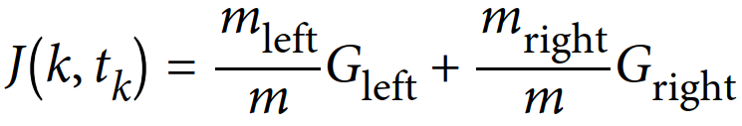














CART algorithm

Slide 13



Impurity measurements
Gini
Entropy:
In thermodynamics:
In Information theory:
In machine learning:

Slide 14
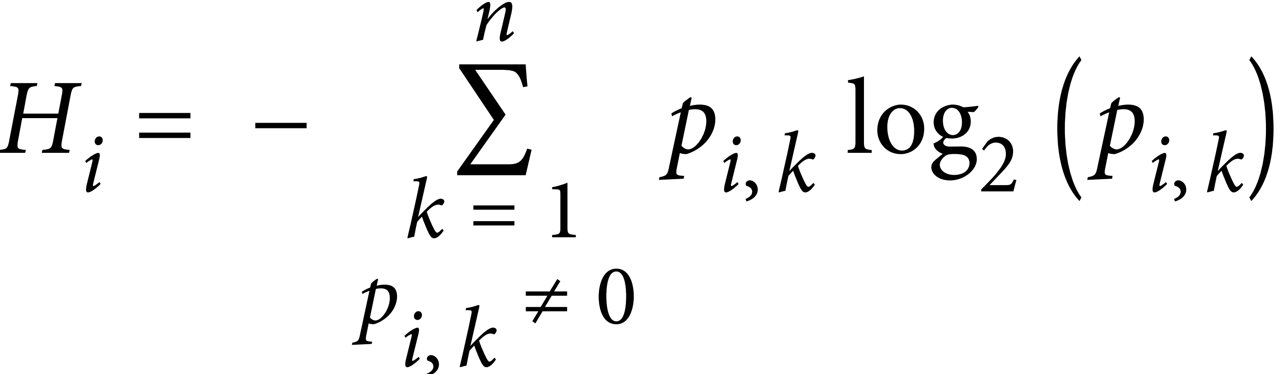




Impurity measurements
Entropy (in machine learning):
For example:

Slide 15

Impurity measurements
Gini impurity or entropy?
most of the time:
Gini impurity:
Entropy:

Slide 16
Parametric models vs Non-parametric models

Slide 17










Parametric vs Non-parametric models
Parametric models: ➔
Non-parametric model:
➔
➔

Slide 18










Regularization for decision trees
Restricts its freedom in training:
max_depth:
min_samples_split:
min_samples_leaf:
max_leaf_nodes:
max_features:
>> Code

Slide 19
Regression with decision trees

Slide 20






Regression with decision trees
>> Code

Slide 21
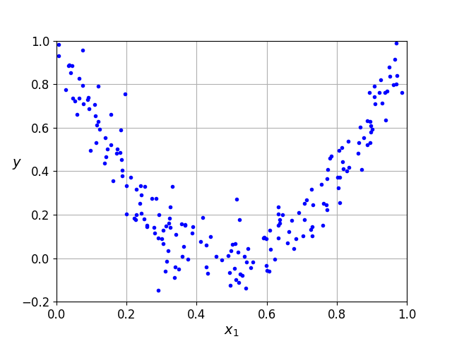
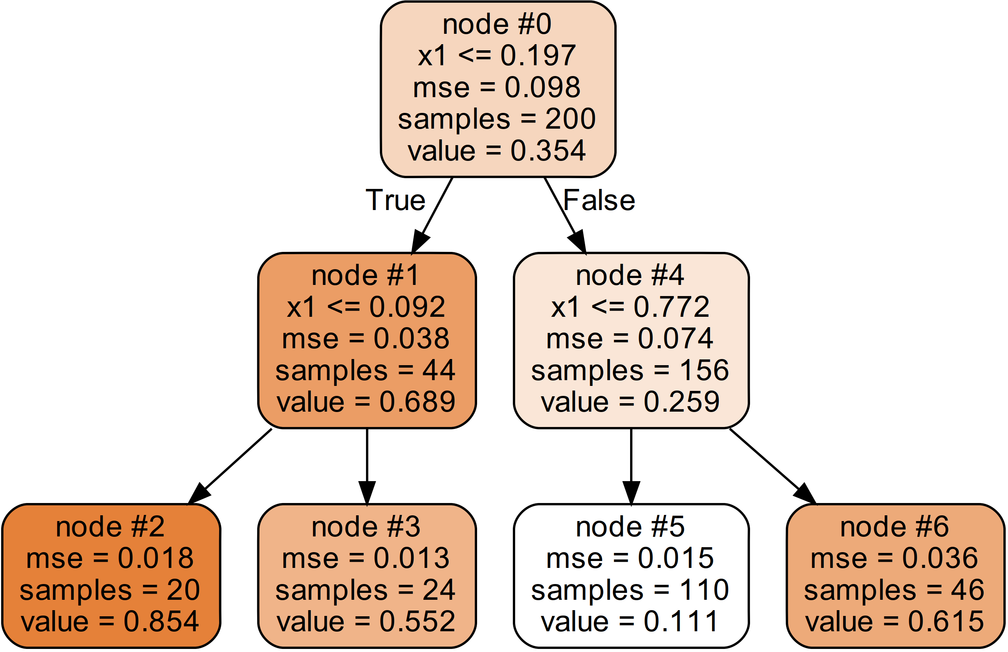








Slide 22










Slide 23
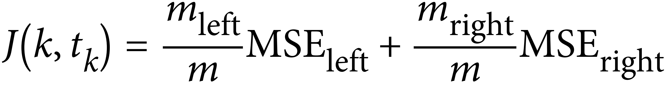




CART algorithm for decision tree regression
The same as earlier, except that instead of trying to minimize impurity,

Slide 24
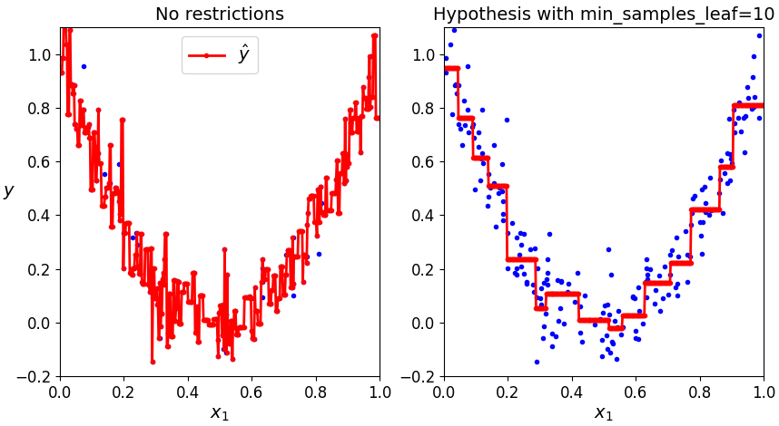








Regularization

Slide 25
Limitations of decision trees

Slide 26







Pros and cons of decision trees
Decision trees are:
However,

Slide 27


Sensitive to data rotation
Decision trees make splits: perpendicular to a feature axis.
➔
>> Code

Slide 28
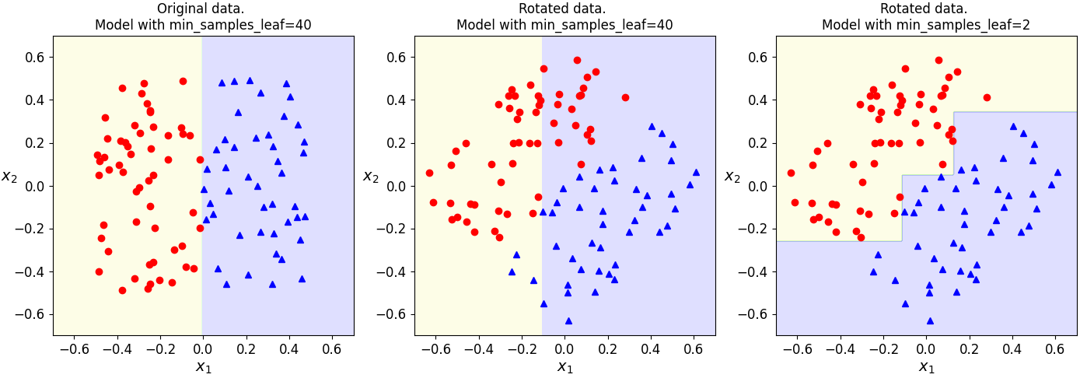


Sensitive to data rotation

Slide 29


“Instable” output model
In training, features are randomly selected to evaluate at each node. ➔ Output models changed from one train to another.
➔

